Slide 1
Foundations of Cryptography perfect secrecy, perfect indistinguishability
LiangFeng Zhang
zhanglf@shanghaitech.edu.cn

Slide 2
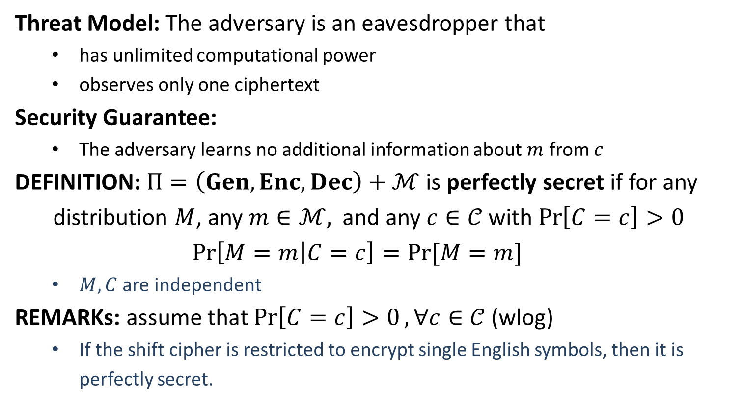
Perfect Secrecy
Threat Model: The adversary is an eavesdropper that
has unlimited computational power
observes only one ciphertext
Security Guarantee:
The adversary learns no additional information about $m$ from $c$
DEFINITION: $Π=\left(Gen, Enc, Dec\right)+ℳ$ is perfectly secret if for any
distribution $M$, any $m∈ℳ,$ and any $c∈𝒞$with $\operatorname{Pr}\left[C=c\right]>0$
$$\operatorname{Pr}\left[M=m | C=c\right]=Pr⁡[M=m]$$
$M,C$ are independent
REMARKs: assume that $\operatorname{Pr}\left[C=c\right]>0, ∀c∈𝒞$ (wlog)
If the shift cipher is restricted to encrypt single English symbols, then it is perfectly secret.

Slide 3
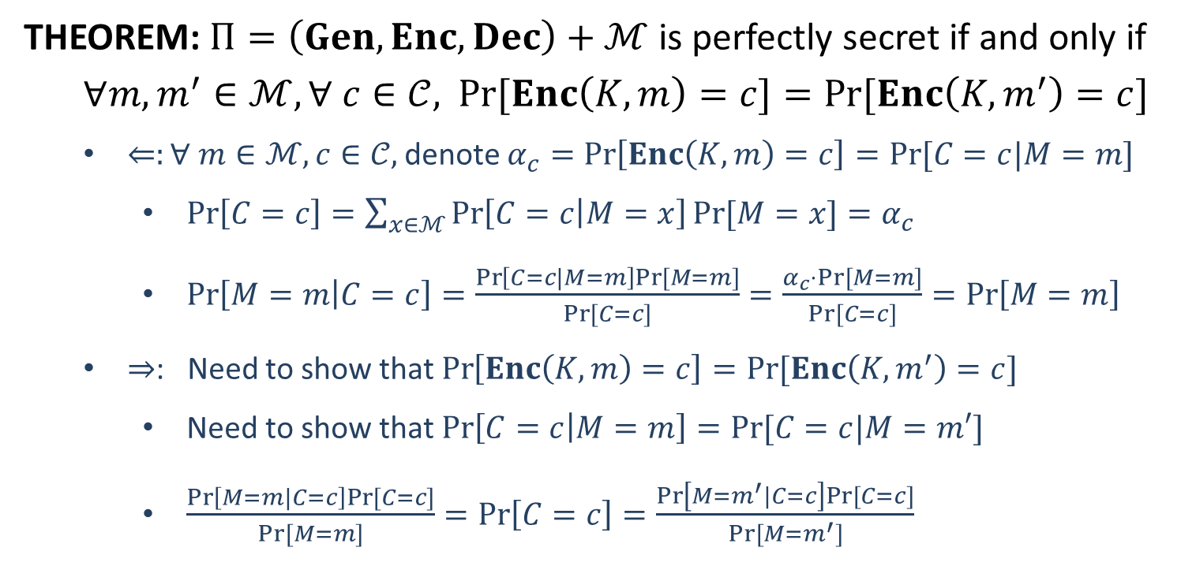
Perfect Secrecy
THEOREM: $Π=\left(Gen, Enc, Dec\right)+ℳ$ is perfectly secret if and only if
$∀m, m^{′}∈ℳ, ∀ c∈𝒞,$ $\operatorname{Pr}{[Enc\left(K,m\right)=c]}=Pr⁡[Enc\left(K,m^{′}\right)=c]$
$⇐:∀ m∈ℳ, c∈𝒞,$denote $α_{c}=\operatorname{Pr}\left[Enc\left(K,m\right)=c\right]=Pr⁡[C=c|M=m]$
$\operatorname{Pr}\left[C=c\right]=\sum_{x∈ℳ}{\operatorname{Pr}\left[C=c | M=x\right]Pr⁡[M=x]}=α_{c}$
$\operatorname{Pr}\left[M=m | C=c\right]=\frac{\operatorname{Pr}\left[C=c|M=m\right]Pr⁡[M=m]}{Pr⁡[C=c]}=\frac{α_{c}⋅Pr⁡[M=m]}{Pr⁡[C=c]}=\operatorname{Pr}\left[M=m\right]$
$⇒$: Need to show that $\operatorname{Pr}\left[Enc\left(K,m\right)=c\right]=Pr⁡[Enc\left(K,m^{′}\right)=c]$
Need to show that $\operatorname{Pr}\left[C=c | M=m\right]=Pr⁡[C=c|M=m′]$
$\frac{\operatorname{Pr}\left[M=m|C=c\right]Pr⁡[C=c]}{Pr⁡[M=m]}=\operatorname{Pr}\left[C=c\right]=\frac{\operatorname{Pr}\left[M=m^{′}|C=c\right]Pr⁡[C=c]}{Pr⁡[M=m^{′}]}$

Slide 4


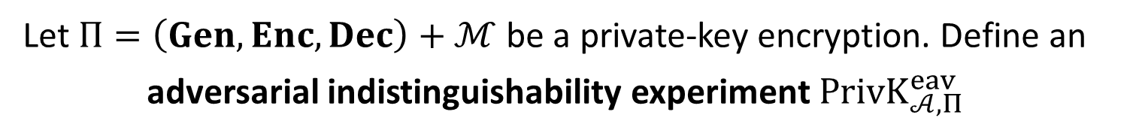



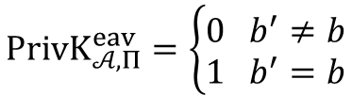




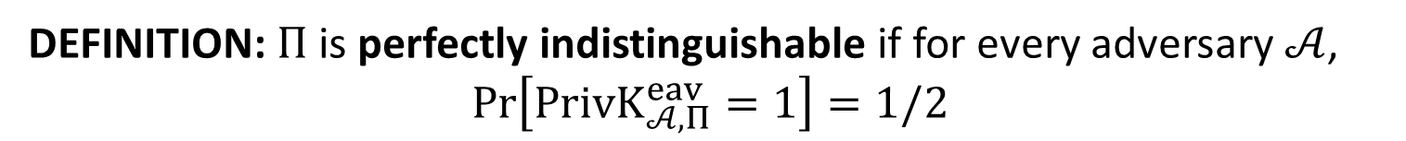
Perfect Indistinguishability
Let $Π=\left(Gen, Enc, Dec\right)+ℳ$ be a private-key encryption. Define an
adversarial indistinguishability experiment $PrivK_{𝒜, Π}^{eav}$
choose $m_{0}, m_{1}∈ ℳ$
$$m_{0},m_{1}$$
$$k←Gen$$
$$b←\{0,1\}$$
$$Challenger$$
$$c←Enc(k,m_{b})$$
$$c$$
$$Adversary 𝒜$$
$$b′$$
$$PrivK_{𝒜, Π}^{eav}=\left\{\begin{aligned}0 b^{′}≠b \\ 1 b^{′}=b\end{aligned}\right.$$
DEFINITION: $Π$is perfectly indistinguishable if for every adversary $𝒜$,
$$\operatorname{Pr}\left[PrivK_{𝒜, Π}^{eav}=1\right]=1/2$$

Slide 5
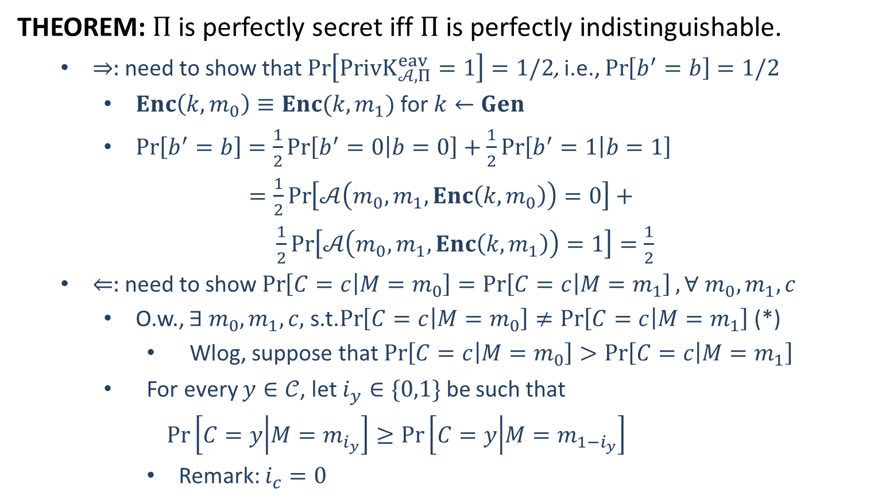
Perfect Indistinguishability
THEOREM: $Π$is perfectly secret iff $Π$ is perfectly indistinguishable.
$⇒:$ need to show that $\operatorname{Pr}\left[PrivK_{𝒜, Π}^{eav}=1\right]=1/2$, i.e., $\operatorname{Pr}\left[b^{′}=b\right]=1/2$
$Enc\left(k,m_{0}\right)≡Enc(k,m_{1})$ for $k←Gen$
$\operatorname{Pr}\left[b^{′}=b\right]=\frac{1}{2}\operatorname{Pr}\left[b^{′}=0 | b=0\right]+\frac{1}{2}\operatorname{Pr}\left[b^{′}=1 | b=1\right]$
$=\frac{1}{2}\operatorname{Pr}\left[𝒜\left(m_{0},m_{1},Enc\left(k,m_{0}\right)\right)=0\right]+$
$\frac{1}{2}\operatorname{Pr}\left[𝒜\left(m_{0},m_{1},Enc\left(k,m_{1}\right)\right)=1\right]=\frac{1}{2}$
$⇐:$ need to show $\operatorname{Pr}\left[C=c | M=m_{0}\right]=\operatorname{Pr}\left[C=c | M=m_{1}\right], ∀ m_{0},m_{1},c$
O.w., $∃ m_{0},m_{1},c,$s.t.$\operatorname{Pr}\left[C=c | M=m_{0}\right]≠\operatorname{Pr}\left[C=c | M=m_{1}\right]$ (*)
Wlog, suppose that $\operatorname{Pr}\left[C=c | M=m_{0}\right]>\operatorname{Pr}\left[C=c | M=m_{1}\right]$
For every $y∈𝒞$, let $i_{y}∈\{0,1\}$ be such that
$$\operatorname{Pr}\left[C=y | M=m_{i_{y}}\right]≥\operatorname{Pr}\left[C=y | M=m_{1−i_{y}}\right]$$
Remark: $i_{c}=0$

Slide 6
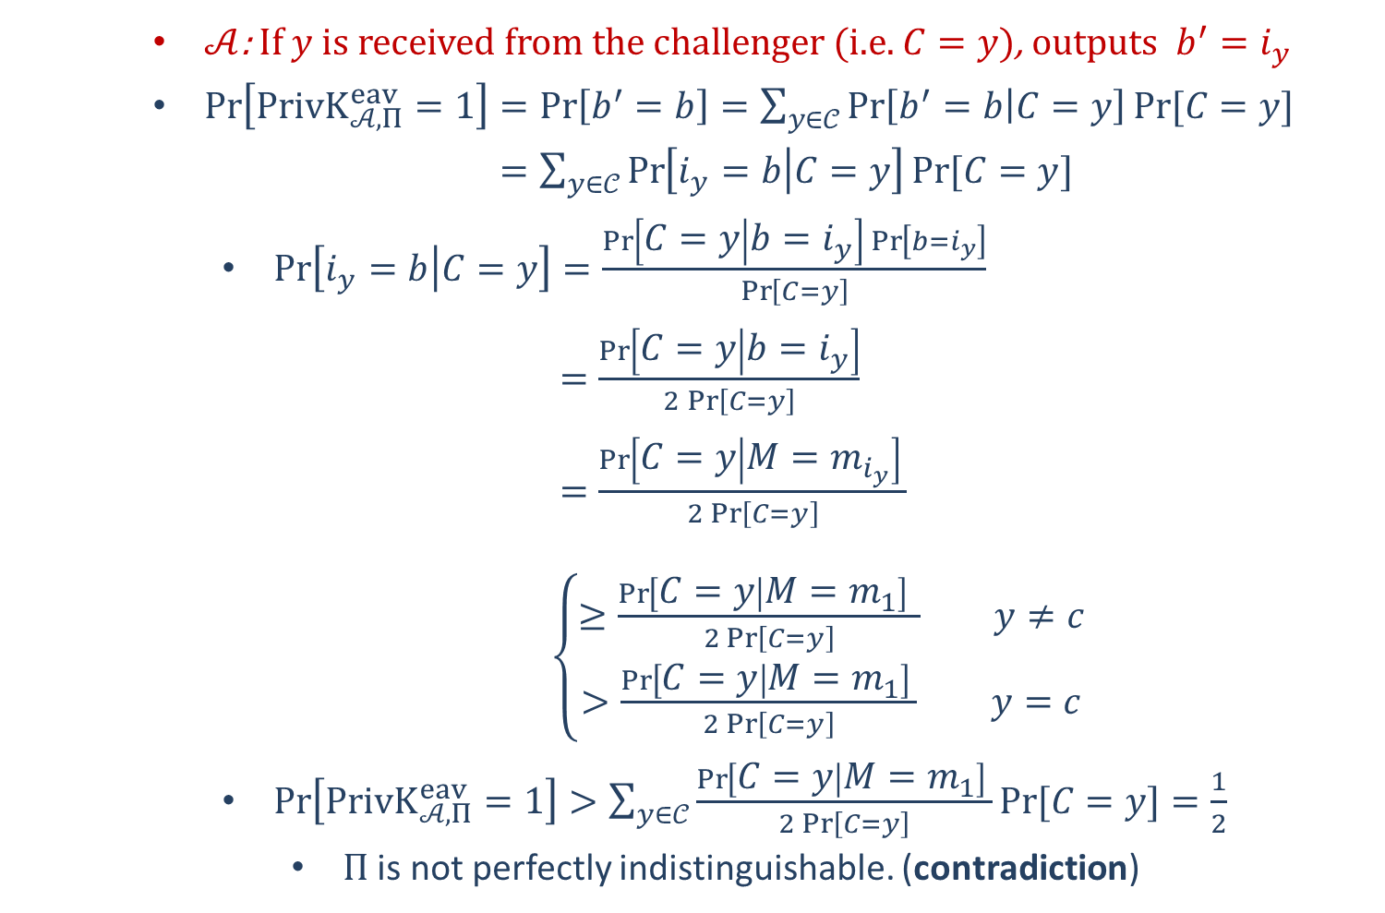
$𝒜$: If $y$ is received from the challenger (i.e. $C=y$), outputs $b^{′}=i_{y}$
$\operatorname{Pr}\left[PrivK_{𝒜, Π}^{eav}=1\right]=\operatorname{Pr}\left[b^{′}=b\right]=\sum_{y∈𝒞}{\operatorname{Pr}\left[b^{′}=b | C=y\right]Pr⁡[C=y]}$
$=\sum_{y∈𝒞}{\operatorname{Pr}\left[i_{y}=b | C=y\right]Pr⁡[C=y]}$
$\operatorname{Pr}\left[i_{y}=b | C=y\right]=\frac{\operatorname{Pr}\left[C=y | b=i_{y}\right]\operatorname{Pr}\left[b=i_{y}\right]}{\operatorname{Pr}\left[C=y\right]}$
$=\frac{\operatorname{Pr}\left[C=y | b=i_{y}\right]}{2\operatorname{Pr}\left[C=y\right]}$
$=\frac{\operatorname{Pr}\left[C=y | M=m_{i_{y}}\right] }{2\operatorname{Pr}\left[C=y\right]}$
$\left\{\begin{aligned}≥\frac{\operatorname{Pr}\left[C=y | M=m_{1}\right] }{2\operatorname{Pr}\left[C=y\right]} y≠c \\ >\frac{\operatorname{Pr}\left[C=y | M=m_{1}\right] }{2\operatorname{Pr}\left[C=y\right]} y=c\end{aligned}\right.$
$\operatorname{Pr}\left[PrivK_{𝒜, Π}^{eav}=1\right]>\sum_{y∈𝒞}{\frac{\operatorname{Pr}\left[C=y | M=m_{1}\right] }{2\operatorname{Pr}\left[C=y\right]}Pr⁡[C=y]}=\frac{1}{2}$
$Π$ is not perfectly indistinguishable. (contradiction)

